Slide 1
Business Process Reengineering (BPR)
This material was collected from different sources

Slide 2
Business Processes
Process : A specific ordering of work activities across time and space, with a beginning, an end, and clearly identified inputs and outputs: a structure for action.
Business Process: A group of logically related tasks that use the firm's resources to provide customer-oriented results in support of the organization's objectives
Total Quality Management - Spring 2010 - IUG

Slide 3
Business Processes
A process is a series of activities or steps used to transform input(s) into output(s).
An input or output may exist or occur in the form of data, information, raw material, partially finished units, purchased parts, a product or service, or the environment.
It is the steps used by an individual or a group to perform work or complete a task.
It is sometimes referred to as a technique, method, or procedure.
Total Quality Management - Spring 2010 - IUG

Slide 4
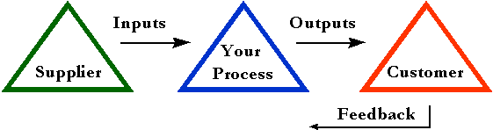
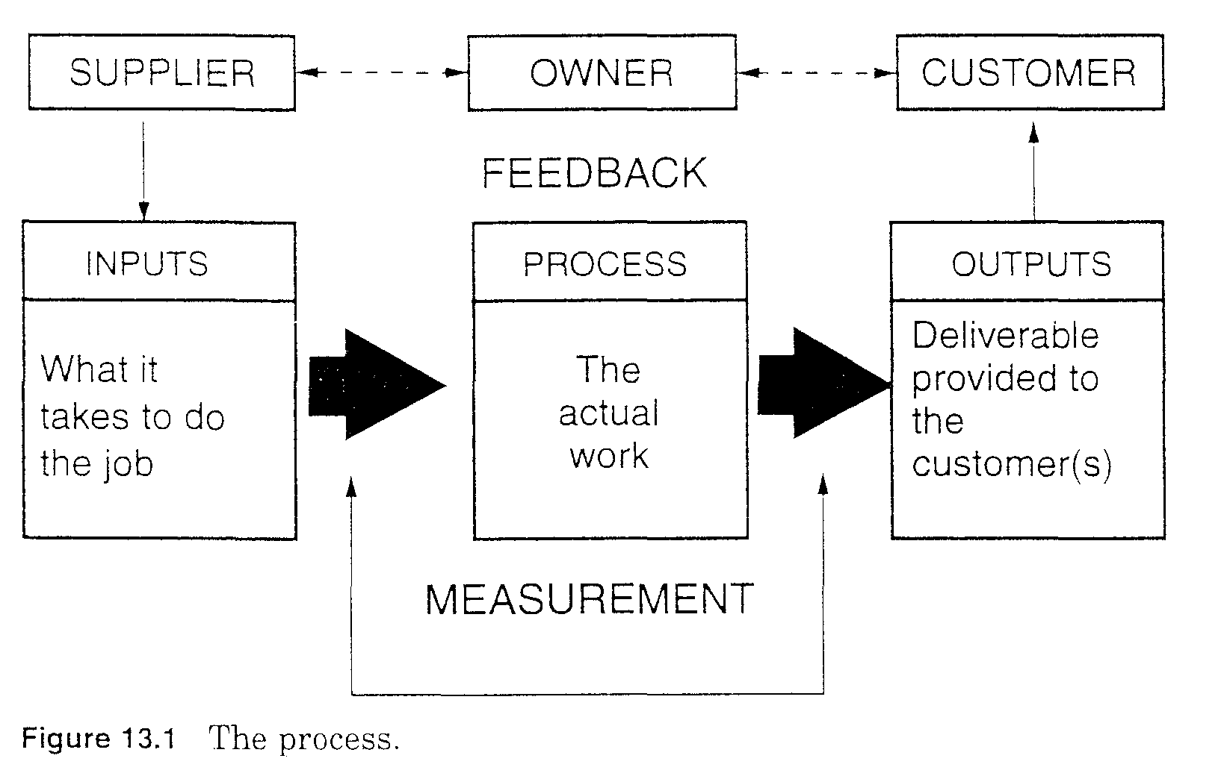
Business Processes
Total Quality Management - Spring 2010 - IUG

Slide 5
PROCESS APPROACH TO MANAGEMENT
Men
PROCESS
Materials
Output
Methods
Machines
Scrap
Environment
Feedback
Corrective Action
Total Quality Management - Spring 2010 - IUG

Slide 6
The Key Roles of Process Management
Effective Process Management requires 4 Key Roles:
“The Process Sponsor” is the person who provides direction and ensures that there is sufficient resource available to improve process. He or She is normally at a senior level in an organization.
“The Process Owner” usually sits outside the process, and is directly and personally accountable for the end-to-end process. He or She is the final arbiter for the process and should drive any process improvement initiatives and activities.
“The Process Manager” works inside the process and is responsible for discrete parts of it. He or She ensures day-to-day production performance, directly manages process workers and suppliers relationships and provides the process owner with metrics, reports and improvement ideas.
“The Process Worker” works inside the process with responsibility for specific delivery to agreed standards. He or She may manage small teams of less experienced workers and provide the process manager with metrics, reports and improvement ideas.
Total Quality Management - Spring 2010 - IUG

Slide 7
Types of Processes
There are three types of processes, as follows:
Management process — This entails the method(s) used by management in executing its management functions. Three key functional areas used by management are planning, organizing, and controlling.
Functional process — A functional process consists of the methods used to achieve functional objectives within a group or by an individual.
Total Quality Management - Spring 2010 - IUG

Slide 8
Types of Processes
Cross -functional process — This includes the method(s) used to achieve objectives that require participation or input from more than one group or individual. For example, the problem of an adverse drug reaction in a hospital may require the involvement of the pharmacist, the ordering physician, a registered nurse, and a unit secretary. Each group or individual controls one or more of the sub-processes affecting the problem.
Total Quality Management - Spring 2010 - IUG

Slide 9

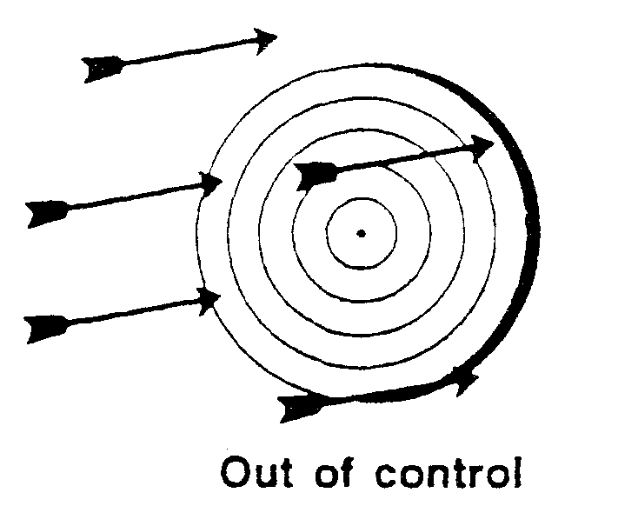
Process States
State 1 is the unknown state. In this state, the process performance has not been measured. There is no target.
State 2 shows the process out of control. There is a target, but the performance cannot be predicted. In this state, the process performance is an element of chance.
Total Quality Management - Spring 2010 - IUG

Slide 10
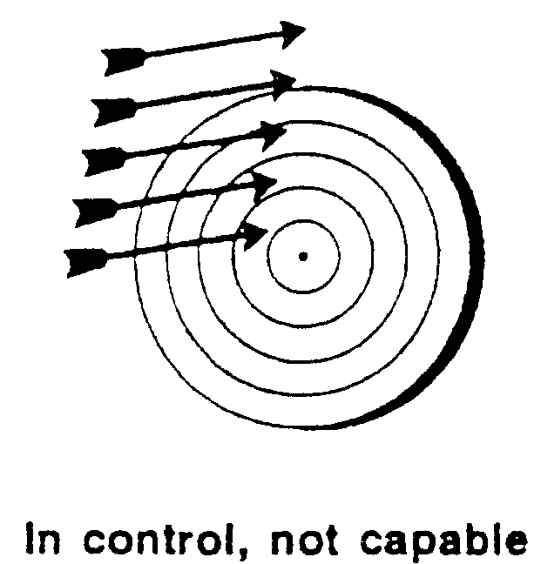
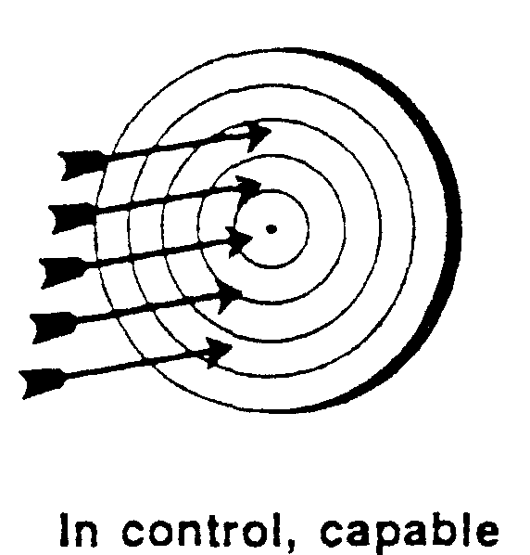
Contd..
State 3 displays a process in control, but the process is not capable. Performance can be predicted, but it will not always hit the target. In this state, the process is not within limits.
State 4 is a process in control and capable. Process performance can be predicted within the target.
Total Quality Management - Spring 2010 - IUG

Slide 11
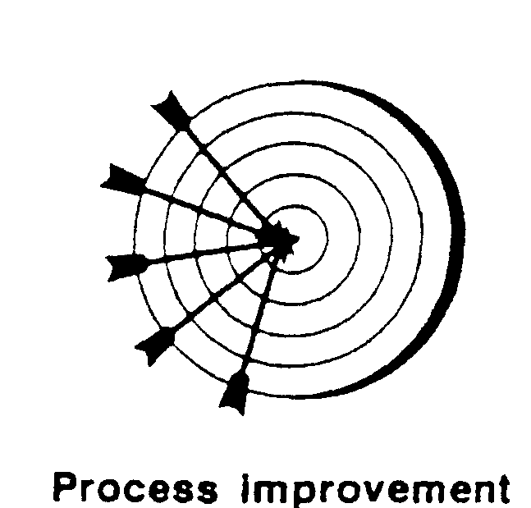
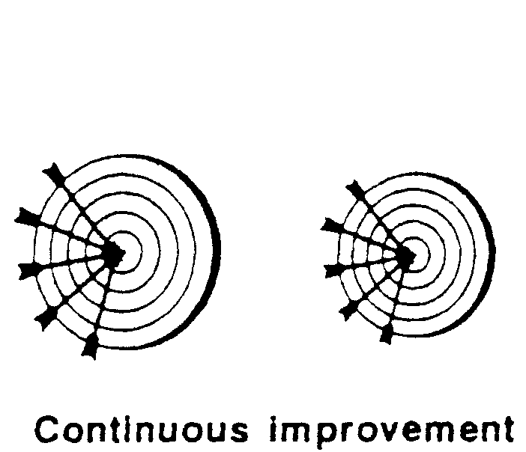
Contd..
State 5 is process improvement. In this state, the process is improved to reduce variability to the target value. The aim is to consistently hit the bull’s-eye or center of the target.
State 6 is continuous improvement. In this state, the process is constantly improved to its best possible performance. The target keeps getting smaller and smaller while still continuously hitting the bull’s-eye.
Total Quality Management - Spring 2010 - IUG

Slide 12
Process Measurement
All process performance can be measured through process indicators. The major process indicators focus on quality, cost, quantity, time, accuracy, reliability, flexibility, effectiveness, efficiency, and customer satisfaction.
Each organization and process owner must determine their own process performance indicators.
Total Quality Management - Spring 2010 - IUG

Slide 13
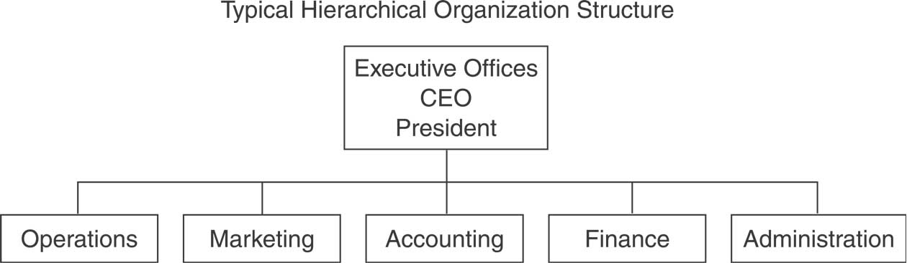

Process Perspective
Total Quality Management - Spring 2010 - IUG

Slide 14
Process Perspective
Keeps the big picture in view.
Focuses on work being done to create optimal value for the business.
Advantages:
  Helps avoid or reduce duplicate work.
  Facilitate cross-functional communication.
  Optimize business processes.
When managers gain the process perspective they begin to lead their organizations to change.
Question status quo (current situation).
Don’t accept “because we have always done it that way” as an answer to why business is done in a particular way.
Allows managers to analyze business’s processes in light of larger goals.
Total Quality Management - Spring 2010 - IUG

Slide 15
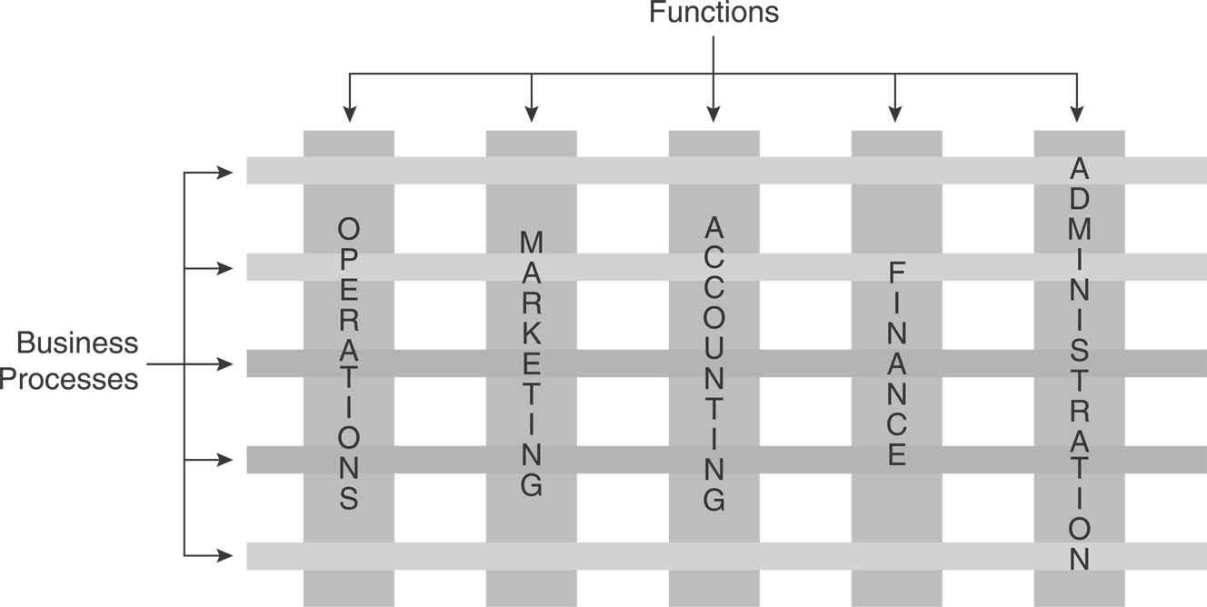
Cross-functional nature of business processes
Total Quality Management - Spring 2010 - IUG

Slide 16
Business Process Reengineering (BPR)
Definition:
Fundamental Rethinking and radical redesign of business processes to achieve dramatic improvements in critical contemporary measures of performance such as cost, quality service, job satisfaction, and speed.
BPR takes a process view of organization, and focuses on how work is accomplished.
BPR is a methodological process that uses information technology to radically overhaul business process and thereby attain major business goals.
BPR is the reconfiguration of business using IT as a central lever.
Overhauling the business processes and organization structure that limit the competitiveness, effectiveness, and efficiency of the organization.
Total Quality Management - Spring 2010 - IUG

Slide 17
Business Process Reengineering (BPR)
Critical issues that define BPR:
BPR consists of radical or at least significant change.
BPR focuses on process not on department or functional areas.
BPR tries to achieve major goals or dramatic performance improvement.
IT is a critical enabler of BPR.
Organizational changes are critical to BPR.
Total Quality Management - Spring 2010 - IUG

Slide 18
Business Process Reengineering (BPR)
Characteristics of BPR:
Process Orientation | An organization should be viewed and organized as a portfolio of processes, not as a functional hierarchy.
Radical and discontinuous Improvement | Look only for dramatic returns and don’t use the present as a basis for the redesigned solution.
Customer Orientation | Process activities are evaluated in terms of the value they create to the external/internal customer.
Empowerment | Shift authority and accountability to the front line worker.
Top Down | Top management initiates, controls, and monitors the exercise, due to the broad cross-functional scope.
IT enabled | Creative use of IT to enable process innovation, not just automate current activities.
Total Quality Management - Spring 2010 - IUG

Slide 19
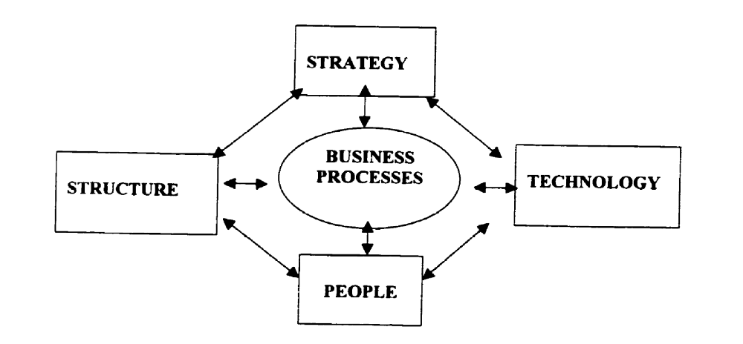
Business Process Reengineering (BPR)
Dimensions of BPR:
Total Quality Management - Spring 2010 - IUG

Slide 20
BPR Implementation
BPR is therefore an approach and takes the form of a project, typically having seven phases:-
Discover
Analyze and Document the redesigned Process(es)
Involve and rebuild
Reorganize and re-train
Establish the redesigned process(es) & redesign the work teams.
Measure Performance
Continuous redesign and improvement
Total Quality Management - Spring 2010 - IUG

Slide 21
Discover Phase:-
A problem or unacceptable outcome is identified and desired outcome determined. This includes:-
  Business Needs
  Processes Involved
  And Effectiveness of Monitoring & measurement Plans.
Total Quality Management - Spring 2010 - IUG

Slide 22
Analyze the Existing Process(es) and Document the Redesigned Process(es):-
  Analyze the current business process(es) & determine new & re-designed Process(es).
  Establish Process Flow Charting for Redesigned Process(es).
  Measure, Test, Analyze, and Finalize the Redesigned Process(es).
  Use Benchmarking Information, where required.
Total Quality Management - Spring 2010 - IUG

Slide 23
Involve and Rebuild Phase:-
  Redesign & Rebuild the Work Teams.
  The teams must rethink and fully understand the redesigned or new Process(es).
  Everybody should be involved for the agreed Action Plan.
Reorganize and Retrain:-
  For New Technology and New or Redesigned Processes.
  BPR may involve Substantial Investment in Training and Top Management’s Commitment / Support.
Total Quality Management - Spring 2010 - IUG

Slide 24
Establish the Re-designed Process(es) With Re-designed Work Teams:-
It is critical for the success of BPR and depends on the scope of the Business Process(es). It therefore includes:-
  Establish & Implement the Re-designed process(es) with Re-designed work teams (where required)
  Overall Process Sponsor or Champion (Effective Managerial Skills)
  Process Owner (Resolver of Process Bottlenecks)
  Team Leader or Process Manager (Motivator & Resource Provider)
  Facilitator (Coordinator & Support Services)
  Team Members (Knowledge, Skills, Attitudes)
Total Quality Management - Spring 2010 - IUG

Slide 25
Business Process Reengineering (BPR)
Measurement of BPR outcomes:
There are no consistent reliable measures available
BPR could be measured during the evaluation stage in terms of:
  Process performance: cycle time, cost, customer satisfaction.
  IT performance: downtime, system use.
  Productivity indices: orders processed per hour.
Total Quality Management - Spring 2010 - IUG

Slide 26
Business Process Reengineering (BPR)
Indicators for success:
Work units change from functional departments to process teams.
Task-oriented jobs become multi-dimensional, process oriented roles.
Employees are empowered with authority and responsibility for a process and its outcome.
Comprehensive employee education replaces skill training.
Organizational culture shifts from protective to productive.
Total Quality Management - Spring 2010 - IUG

Slide 27
Business Process Reengineering (BPR)
Results-oriented performance management and compensation systems are established.
Managers become coaches rather than supervisors.
Hierarchy flattens as a result of empowered process teams.
Executives become leaders rather than scorekeepers.
Total Quality Management - Spring 2010 - IUG

Slide 28
Business Process Reengineering (BPR)
Addressing people issues:
Intervention for overcoming organizational resistance and political pressure.
Intervention for culture change and
Dealing with the 'survivor syndrome' of the change receptionist.
Survivor syndrome appears after firing some employees when implementing BPR, other employees show decreased motivation and morale, guilt, anger, and skepticism.
Total Quality Management - Spring 2010 - IUG

Slide 29
Business Process Reengineering (BPR)
Challenges associated with BPR:
Poor Leadership
Poor or inconsistent communication
Exclusion of current employees
Total Quality Management - Spring 2010 - IUG

Slide 30
Business Process Reengineering (BPR)
Information Technology and BPR:
Practically, IT is a key enabler of process change.
Successful reengineering efforts require a partnership between business and IT professionals.
IT is accompanied by other organizational changes like structure, culture, and role.
Information sharing across an organization.
Great demand among employees to learn new processes.
Total Quality Management - Spring 2010 - IUG

Slide 31
Business Process Reengineering (BPR)
IT opportunities for process reengineering:
Automation: eliminating human labor from a process.
Informational: capturing process information for the purpose of understanding.
Tracking: monitoring process status and objects.
Analytic: improving analysis of information and decision making.
Geographical: coordinating process across distances.
Integrative: coordination between tasks and processes.
Total Quality Management - Spring 2010 - IUG

Slide 32
Business Process Reengineering (BPR)
Differences between traditional IT implementations and BPR:
Basis for comparison | Traditional IT Implementations | BPR implementations
Essence | Problem solving | Reinventing work
Approach | Incremental improvement | Radical change
Style | Analytical | Creative &innovative
Perspective | Micro perspective | Macro perspective
Goal | Enhancement | Paradigm-break
Change | Limited | Wholistic scope
Domain | Functional area | Entire business system
Total Quality Management - Spring 2010 - IUG

Slide 33
Business Process Reengineering (BPR)
Total Quality Management (TQM):
It emphasizes the role of quality in meeting the needs of its customers.
TQM stresses customer satisfaction , continuous improvement and to be the best in all functions.
TQM focuses on incremental change and gradual improvement of processes.
Total Quality Management - Spring 2010 - IUG

Slide 34
Comparison between TQM & BPR
 | TQM | BPR
Change | Incremental | Quantum leap
Focus | Current Practice | Start again
Frequency | Continuous | One shot
Participation | Bottom-up | Top-down
Risk & Rewards | Low & Moderate | High
Type of Change | Work design | Structure, culture roles
Role of IT | Incidental | Key enabler
Total Quality Management - Spring 2010 - IUG

Slide 35
Business Process Reengineering (BPR)
Reengineering Recommendations:
BPR must be accompanied by strategic planning, which addresses leveraging IT as a competitive tool.
Place the customer at the center of the reengineering effort -- concentrate on reengineering fragmented processes that lead to delays or other negative impacts on customer service.
BPR must be "owned" throughout the organization, not driven by a group of outside consultants.
Case teams must be comprised of both managers as well as those will actually do the work.
Total Quality Management - Spring 2010 - IUG

Slide 36
Business Process Reengineering (BPR)
The IT group should be an integral part of the reengineering team from the start.
BPR must be sponsored by top executives, who are not about to leave or retire.
BPR projects must have a timetable, ideally between three to six months.
BPR must not ignore corporate culture and must emphasize constant communication and feedback.
Total Quality Management - Spring 2010 - IUG

Slide 37
BPR is Not?
BPR may sometimes be mistaken for the following five tools:
1. Automation is an automatic, as opposed to human, operation or control of a process, equipment or a system; or the techniques and equipment used to achieve this. Automation is most often applied to computer (or at least electronic) control of a manufacturing process.
2. Downsizing is the reduction of expenditures in order to become financial stable. Those expenditures could include but are not limited to: the total number of employees at a company, retirements, or spin-off companies.
Total Quality Management - Spring 2010 - IUG

Slide 38
BPR is Not?
3. Outsourcing involves paying another company to provide the services a company might otherwise have employed its own staff to perform. Outsourcing is readily seen in the software development sector.
4. Continuous improvement emphasizes small and measurable refinements to an organization's current processes and systems. Continuous improvements’ origins were derived from total quality management (TQM) and Six Sigma.
Total Quality Management - Spring 2010 - IUG

